Slide 1

Customer Lifetime Value

Slide 2
Executive Summary
Motivation:
Coach recently acquired a down-market brand and hopes to better understand how these customers’ lifetime values compare with their up-market customers and how to optimize their offerings to target the down-market customers.
Notes:
Introduce yourself
Jess

Slide 3
Executive Summary
Problems We Solved:
Lack of data for up-market customers: had to make assumptions about their customer lifetime value distribution (greater variability, narrower distribution)
Assumption for the customer base segmentation: when we sampled the customers for the leading top and middle products, we characterized the overall behavior of these respective customer bases

Slide 4
Executive Summary
Findings and Recommendations:
DMCs have a lower average CLV than UMCs
Highest popularity products tend to be purchased by customers with lower CLVs compared to middle popularity products
Focusing on maximizing the high CLV customers in the middle popular products
Promote more niche items that loyal customers are buying (middle products with high CLV)

Slide 5
Business Questions
We are interested in analyzing:
The distribution over lifetime values for down-market customers, and how they compare in the aggregate to the lifetime value of their up-market customers.
The offerings we could produce and market for down-market customers and what constraints we might face when developing new offerings.
How to segment these down-market customers to optimize our messaging.

Slide 6
Business Questions: Expectations
The acquisition of a down-market brand provides Coach with a strategic opportunity to optimize their offerings and marketing to down-market customers based on estimates of customer lifetime value. Provides us with opportunities to:
Potentially grow our customer base and brand loyalty through new offerings and customer segmentation.
Form strategies to promote down-market customers to up-market customers.
Better understand how customer lifetime value estimations can be used to predict marketing campaigns
Notes:
Jess
Brand not as well-known
Differentiate upmarket vs downmarket marketing and customer segments
Highest selling products are bought by customers who are most brand loyal
Targeting to loyal and reliable customers

Slide 7
Business Questions: Hypotheses
We hypothesize that down-market customers have lower CLVs and a wider distribution of CLVs than up-market customers (less brand loyalty and brand recognition)
We also predict that the top 4 highest selling products will reflect a higher CLV customer base for these products (association between most frequently bought products and brand loyalty)
Additionally, we believe targeting to higher CLV customers would be the most optimal strategy (prioritize most loyal and reliable customers)

Slide 8
Data and Methods
We used a pseudo-churn model to analyze the full dataset. This form of modelling is used by most up and coming companies since there are less assumptions required than basic arithmetic.
We are interested in customer satisfaction as a factor in CLV, therefore, we did not remove refunds from the data.
Using predicted churn, we calculated CLV for each customer over their estimated lifetime.
To compare down market to up market customers, we assume that up market CLVs are higher and have a more narrow distribution since they have more brand loyalty
Notes:
Sam

Slide 9
Data and Methods
Using the calculations from the pseudo-churn model, we can examine what products are being purchased the most
Examine the top 20 SKUs
Determine top 4 selling products from SKUs
Compare CLV median statistic between overall and individuals who bought top 4 products and middle selling products
Notes:
Inaara
Finding:
Highest popular products: have lower CLV as opposed to the middle products → shows potential to attract new customers and reflects on the type of customer segmentation
Compare statistics with average selling products (lowest 3rd quartiles selling products)
Analyze the overlap of the customer base for the 4 highest selling products to help inform promotional strategy; i.e. customers disproportionately buying ¾ of the top products can lead to promotion of buying 3 products and getting one 50 % off (TBD - %in% operator troubleshoot)

Slide 10
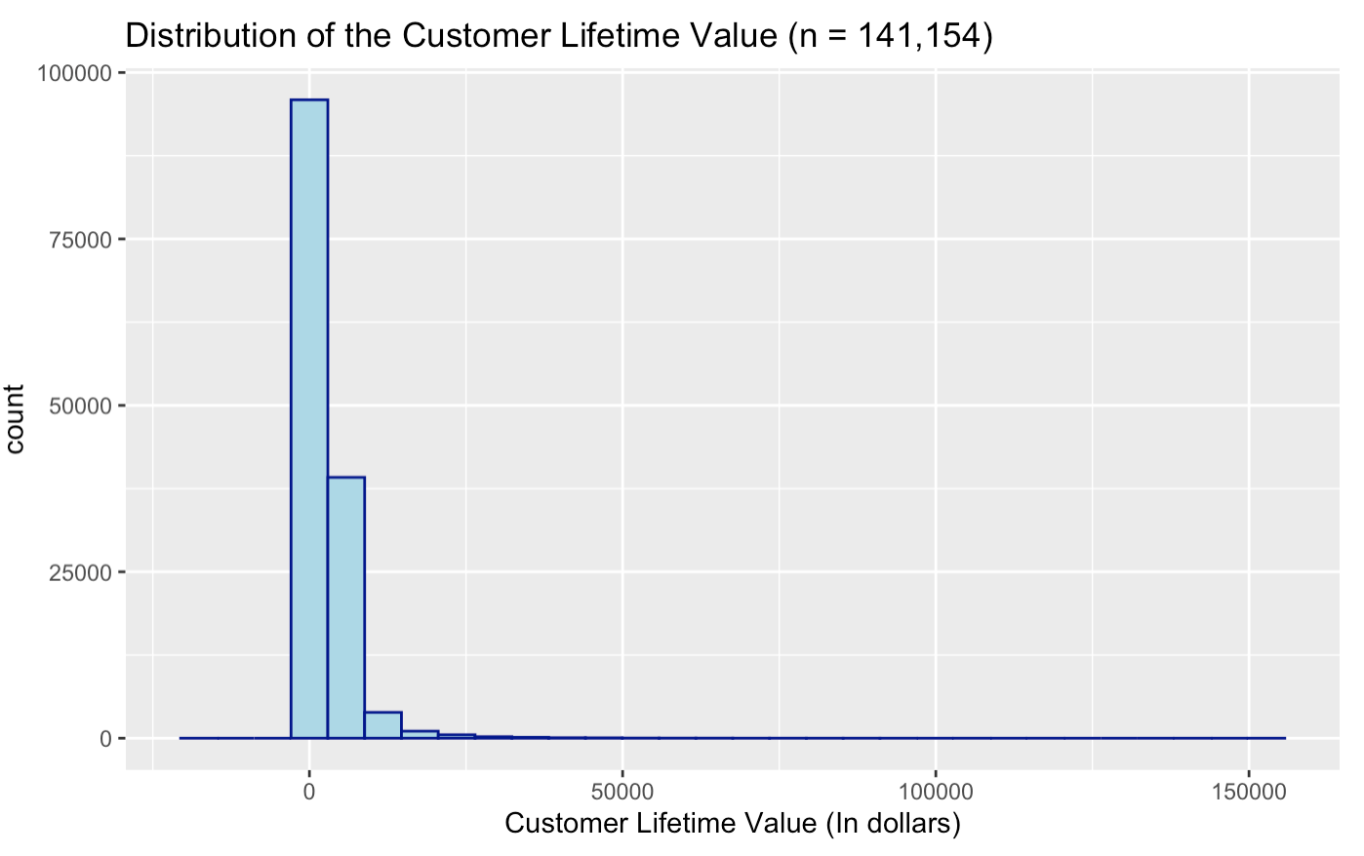
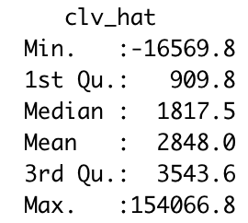
Findings
Notes:
Distribution highly right-skewed
Our range of CLV is very large. You can see that there are some customers that have a CLV in the negatives or around 0, meaning that they have negative or no value to Coach. But we can also see that some customers have a range of being very valuable to Coach, up to 154,066.
Our mean, however is 2,848
Chelsey

Slide 11
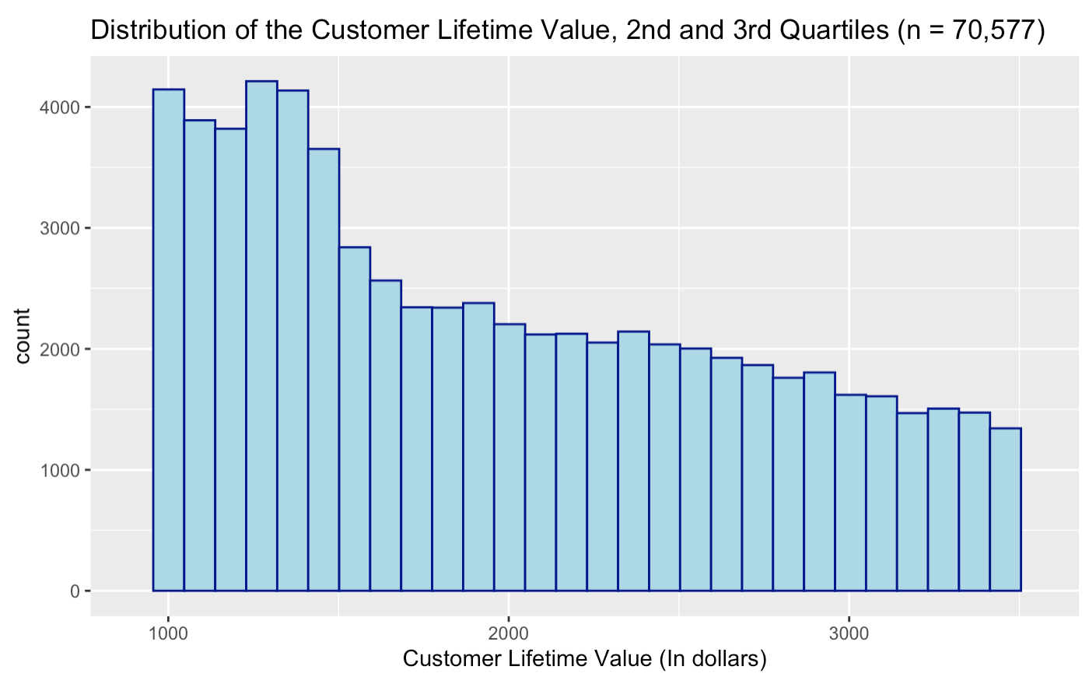
Findings
Notes:
Blown-up histogram
Chelsey

Slide 12
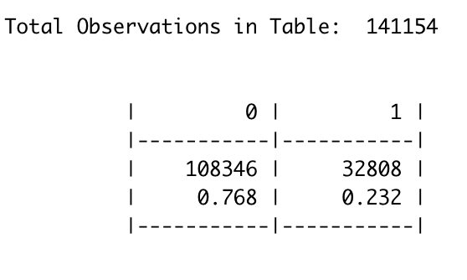
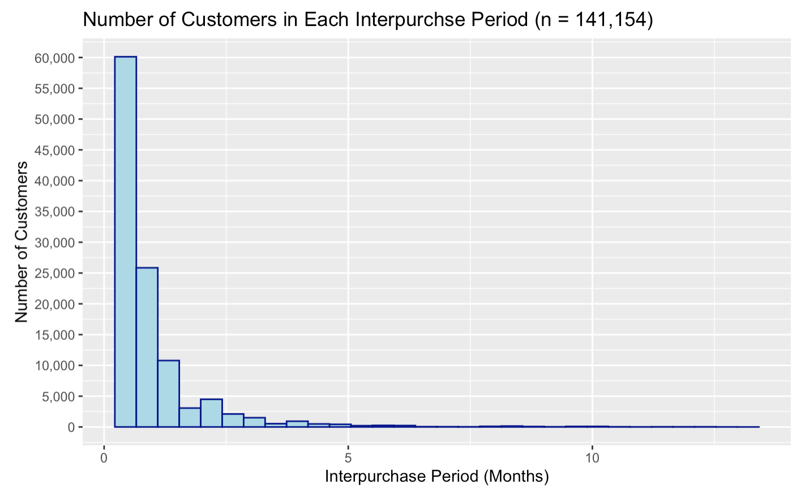
Findings
Notes:
Most down-market customers have a high frequency of purchase (low interpurchase period)
Majority of customers have interpurchase period between 0-2 months
Chelsey

Slide 13
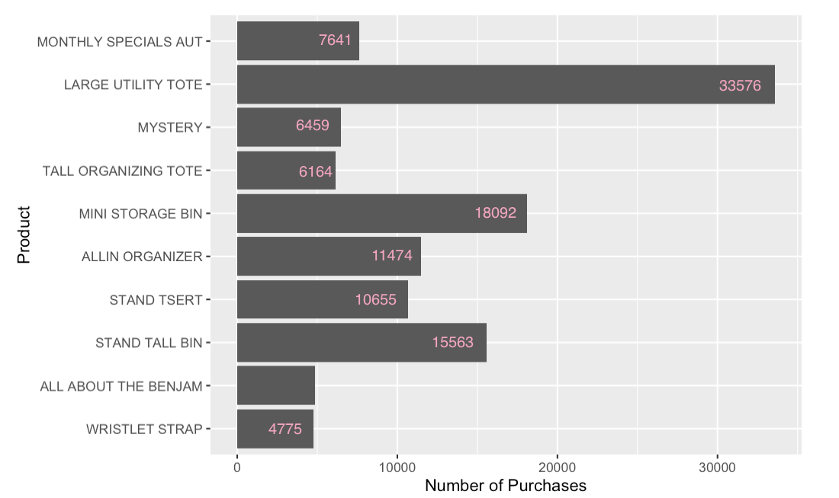
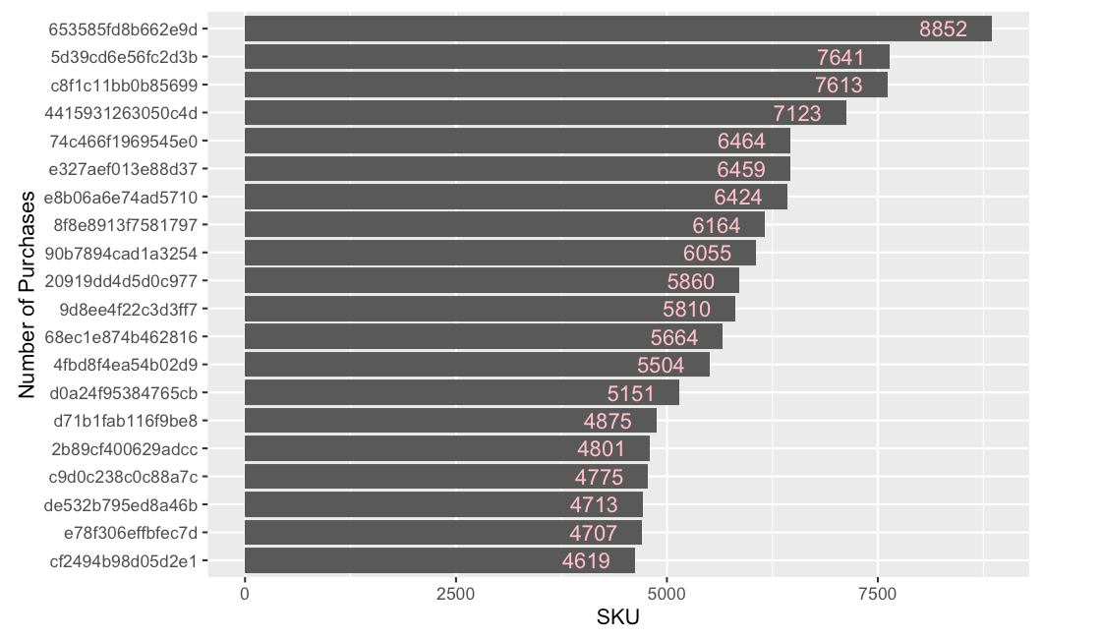
Top 20 SKUs
Top Products
Notes:
Ally

Slide 14
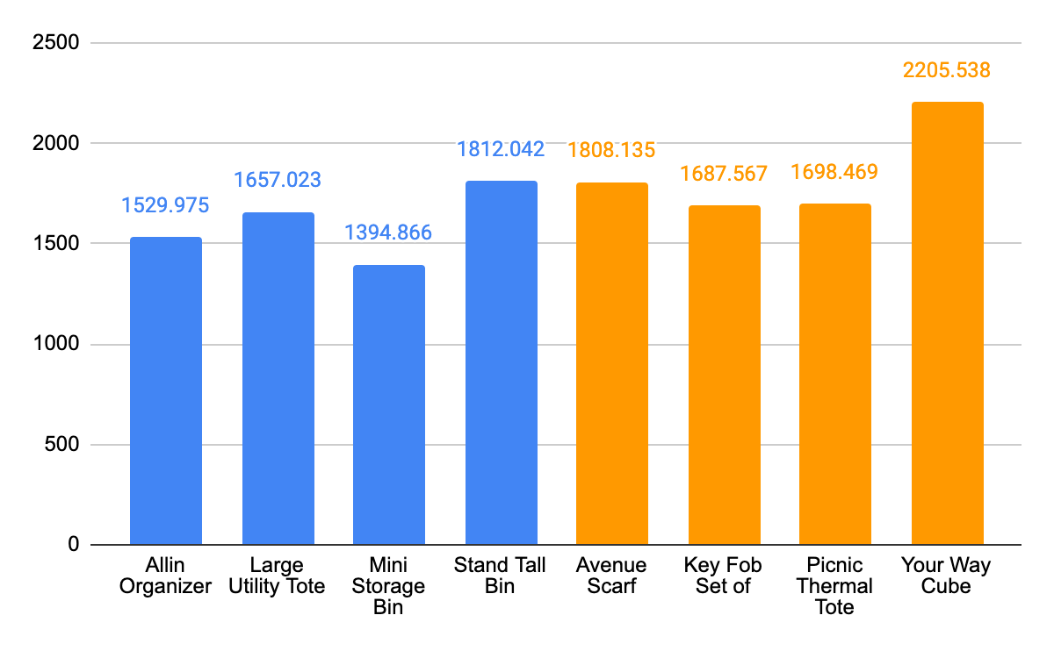
Findings
Top 4 Selling Products:
Sample Average Selling Products:
Large Utility Tote
Mini Storage Bin
Stand Tall Bin
Allin Organizer
Key Fob Set
Picnic Thermal Tote
Avenue Scarf
Your Way Cube
Median
Median
Median: 93
Notes:
Ally

Slide 15
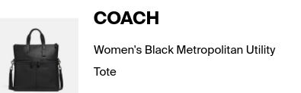
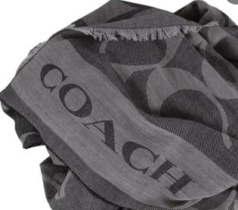
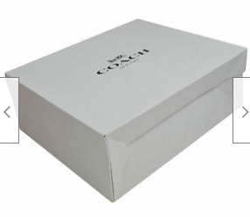
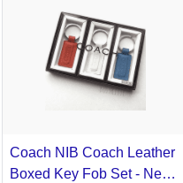

Slide 16
Discussion
In 2020, the average churn for retail brands is 63% (Bloom Intelligence) while average churn for luxury brands are 80-90%. (Hedda)
In our calculations, only about 23% of customers are likely to churn. In comparison to other luxury brands, down market Coach customers are more loyal to the brand. This may explain why customers have a shorter interpurchase period.
Given our up market assumptions, down market customers have a lower average CLV (high churn rate, lower $ amount spend, fewer purchases) and a wider distribution of CLVs than up market customers.
Notes:
Chelsey

Slide 17
Discussion
Surprising finding: Highest 4 selling products had customers with lower CLVs than the middle selling products
Why did the middle selling products have greater customer lifetime value?
High and low CLV both buy popular items
More “unpopular” items are bought by more loyal customers
Notes:
Ali
Answer: It reflects our customer base segmentations.

Slide 18
Recommendations
For optimal strategy,
Segment between high and low CLV for middle selling products
Promote more niche items to more loyal customers (high CLV)
High CLV more likely to purchase
Target both high and low CLV for best selling products
Promote popular items to a greater range of customers
More people are more likely to purchase popular products
Could even attract new customers
Notes:
EX: Gucci belt vs Gucci t-shirt
Belt is a status staple that warrants infrequent buyers which lead to low CLVs
T-shirts would attract high CLV customers who have loyalty to the brand and buy niche branded products often
STRATEGY: Promote more niche items that loyal customers are buying (middle products with high CLV).
Answer: It reflects our customer base segmentations.
Do not focus on high CLV customers with the most popular items. Instead focus on maximizing the high CLV customers in the middle popular products.
Total Gross:
For middle selling products: 106641.64
Higher selling products: 780957.82

Slide 19
Recommendations
Possible Offerings:
Generate greater sales of the popular products
Engage greater range of customers in more popular items:
Introducing new types of popular products (new function, new design, etc.)
Advertisement with popular products
Notes:
Risk: Proven products to sell versus experimenting with different flavors of the product

Slide 20
Recommendations
2. Increasing the CLV of our customer base
Promotions with a more popular product and a middle selling product (ex/ BOGO 50%, etc.)
Attracts both high CLV and lower CLV customers
Increase CLV of customers
Notes:
Inaara
- Goal: convert some of the low CLV customers purchasing popular products into high CLV middle product purchasers. Ex: Help launch their collection of niche fan-centric products through BOGO 50% off promotional sale

Slide 21
Recommendations
Constraints:
Money loss due to unpopular varieties (ie proven products vs experimental products)
Costs in production and marketing
Customer reluctance in spending more money for items that they were not interested in initially (i.e. BOGO 50% off promotion)
Notes:
Inaara
- Goal: convert some of the low CLV customers purchasing popular products into high CLV middle product purchasers. Ex: Help launch their collection of niche fan-centric products through BOGO 50% off promotional sale

Slide 22
Impact: Results of Hypotheses
We need data on up-market customer behavior to make a more definitive comparison between our up-market and down-market customers. However, based off of our current data, it is likely that our down-market customers have a wider distribution and a lower average CLV.
Incorrect: the top 4 highest selling products reflected a lower CLV customer base for these products
Correct: targeting to higher CLV customers is the most optimal strategy; however, they are found in the middle product customer base, not in the top products customer base like we thought initially
Notes:
Sam

Slide 23
Impact
With the Customer Lifetime Value, we now have a picture of Coach’s down and up market in the long-term, and how to optimize its financial viability.
Coach can increase the average CLV per customer in both up market and down market customer populations through targeted promotional strategies.
Social media campaigns will increase both acquisition and retention of customers for Coach, increasing the total revenue for the company.
Increase cost-effectiveness of product production and marketing
Strengthens the loyalty of the customer base
Convert down-market customers to up-market customers
Notes:
Sam

Slide 24
Impact
Resourcing Needs:
Increased hiring of data analytics employees to periodically update the CLV model and evaluate effectiveness.
Hire a robust marketing team that can advertise our differential promotional campaigns towards each customer population. This sale will occur on the 1st of each month.
Notes:
Sam

Slide 25
References
Hedda Schupak, E. (n.d.). New Study Says Luxury Brands Lose 80-90 Percent Of Customers Every Year. Retrieved from
https://news.centurionjewelry.com/articles/detail/new-study-says-luxury-brands-lose-80-90-percent-of-%20customers-every-year#
Johnston, R. (2021, August 09). Is Your Retail Churn Rate Above Average? Retrieved from https://bloomintelligence.com/blog/is-your-retail-churn-rate-above-average/
Perino, M. (2019, February 26). Heres when you should be buying designer goods to get the best deals, according to a Chief Marketing Officer who works with 12,000 luxury brands. Retrieved from https://www.businessinsider.com/best-time-to-buy-designer-fall-winter-spring-summer-sales-2019-2
The anatomy of a retail marketing budget in 2020. Smartly.io - Powering Beautifully Effective Ads. (n.d.). Retrieved September 26, 2021, from https://www.smartly.io/blog/the-anatomy-of-a-retail-marketing-budget-in-2020.
Notes:
Sam

Slide 26
Thank you for your attention.
Any questions?
Notes:
Sam

